Slide 1


An exclusive network connecting London-based freelancer developers.
Notes:
Show screen shot of the app
or,
Swipe to second screen with it on

Slide 2
team:us
Jack Mathews
Davinder Kaur
Ragini Dua
Ali Molloy
Richard Hayim

Slide 3
Background
How we came about this idea be as follows:
Initial idea: sharing across SMEs’
froe as follows:
Real world problem?
froe as follows:
Freelancer collaboration
froe as follows:
Final idea: bespoke team building follows:

Slide 4
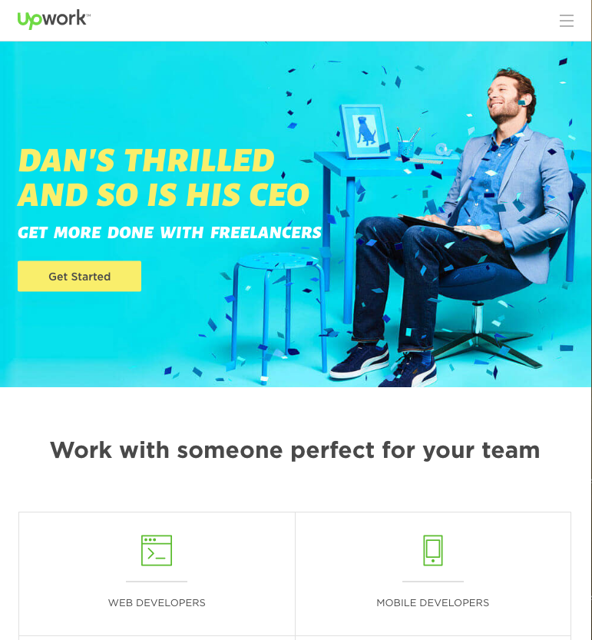
Research
Only products out there are client centre and less empowering for freelancers to independently collaborate

Slide 5
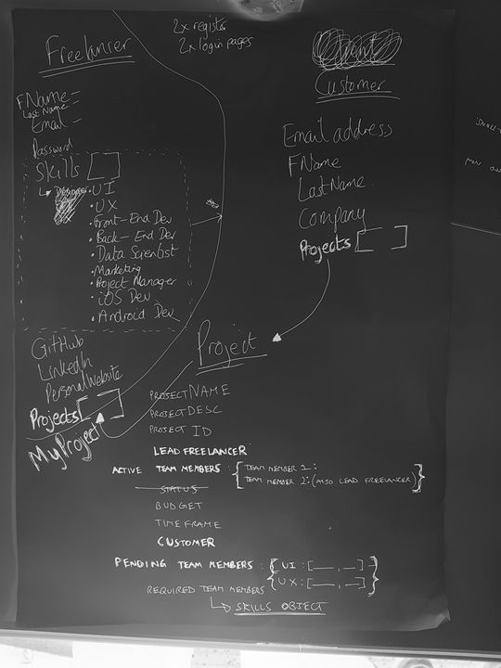
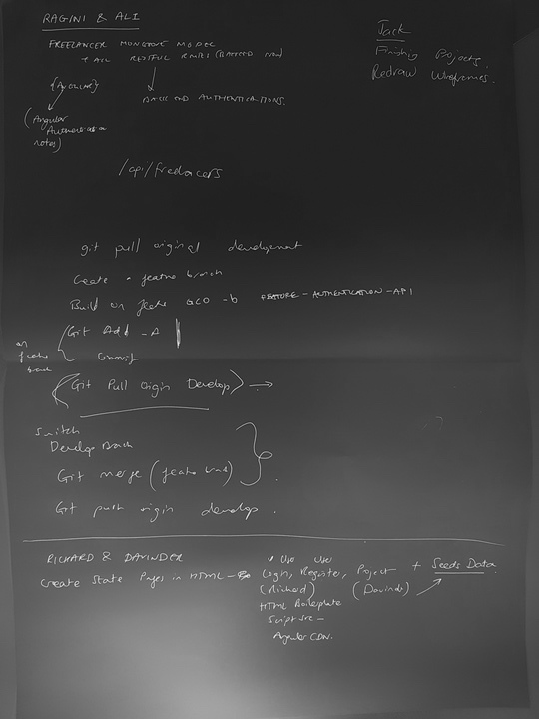
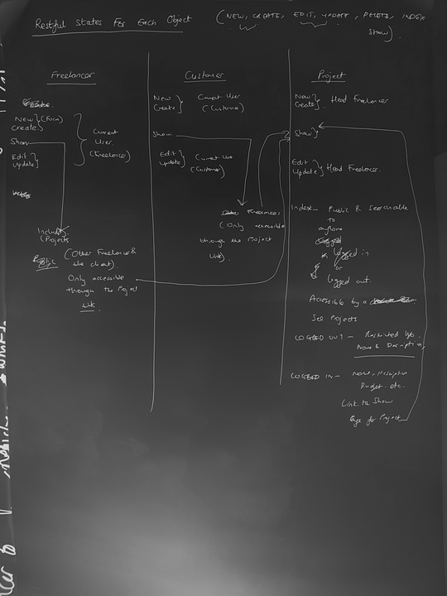
Planning
Mobile first
Clear user journey
Clear development journey!

Slide 6
User journey
Client asks
Head
Freelancer
for work
Head Freelancer needs a team of freelancers to do this job
Head Freelancer designs team specifying role types
& numbers
Head Freelancer
registers on team:up
Head Freelancer creates new project
Project page displays available roles
Requested Freelancer finds project via index
or search
Requested Freelancers registers
Head Freelancer picks roles for self & requests team via email
Requested Freelancer applies for roles
Lead Freelancer logs in to see pending applications
Lead Freelancer builds team from applicant list
Journey
Complete

Slide 7
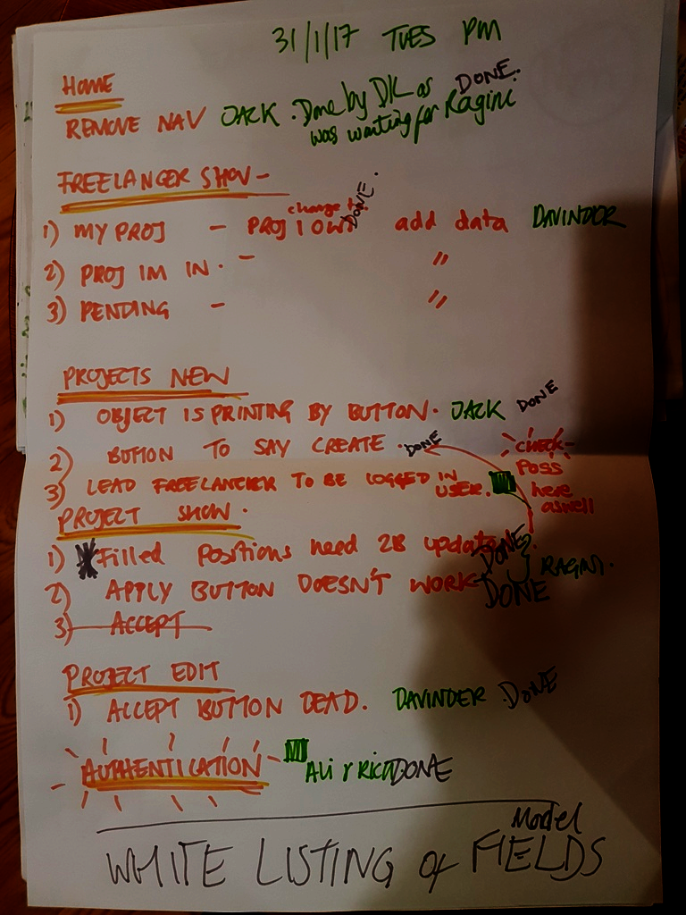
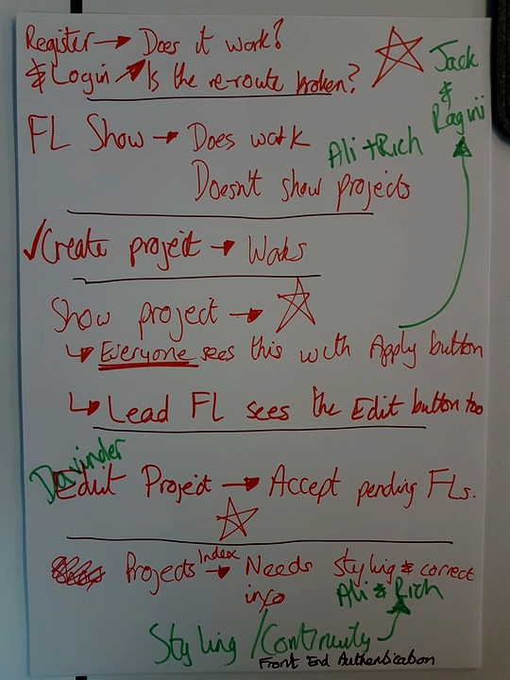
Development Process
Thorough Planning
Regular standups
Lists Vs Trello
Collaborative approach

Slide 8
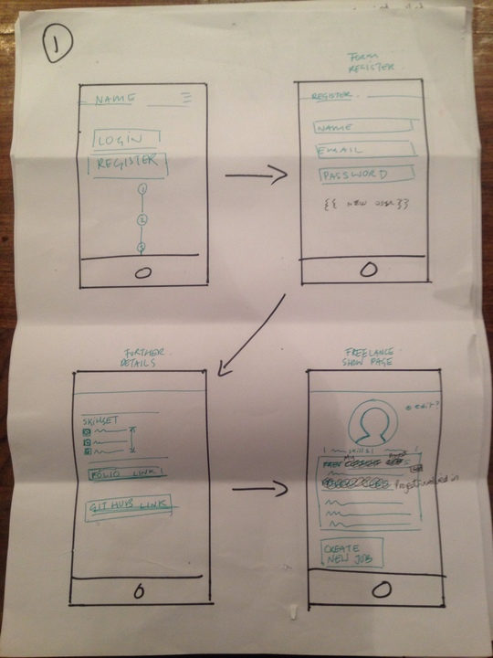
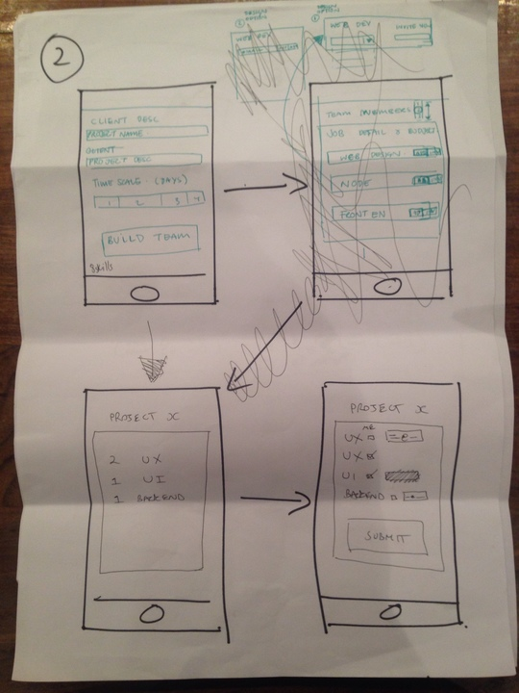
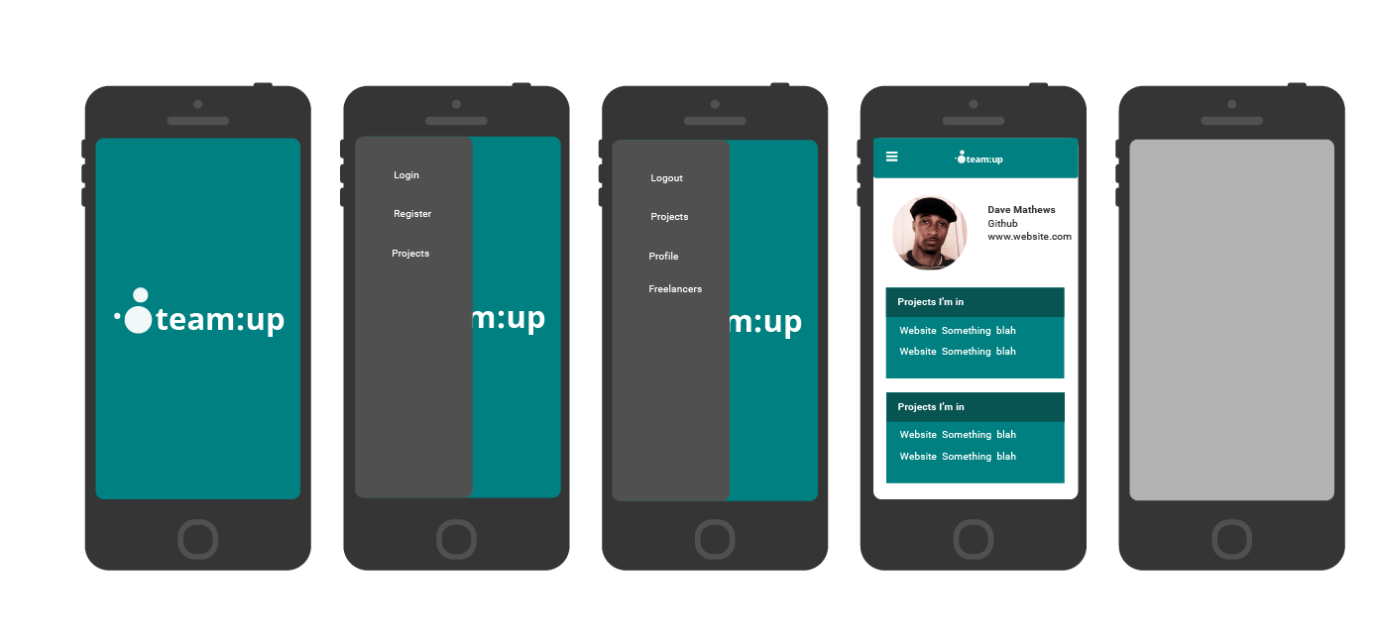
Wireframes
Translating the user story into beautiful pages!

Slide 9
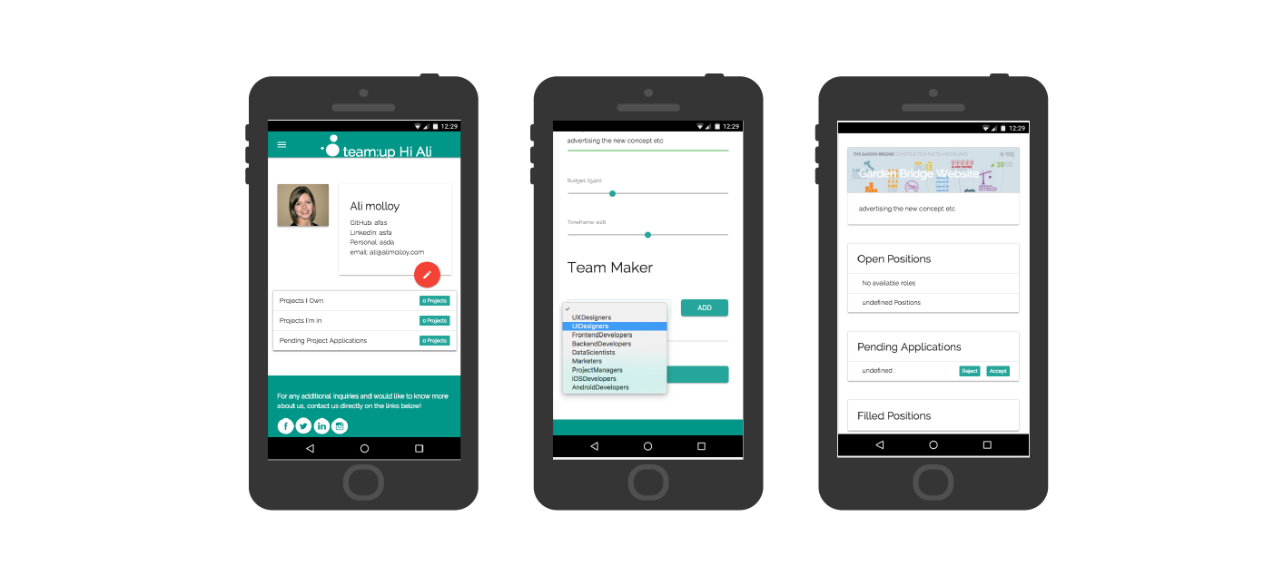
Demo

Slide 10
Successes
Exclusive network
Project search
Build the team you want: accept and reject applications

Slide 11
Challenges
Changing the user story
Deciding MVP features
Technical strategy
Time allocation for work

Slide 12
Onwards & upwards
Lead Freelancer can invite team members via email
Lead Freelancer can edit the team
Lead Freelancer can allocate project budget across the team
Allow the Lead Freelancer to track progress of the project, once the team has been built
Add in functionality for the status of the project (Live / Closed)
Freelancer profile to list out their skills
Freelancer profile to include an availability calendar
Build in a Client model which allows them to request a freelancer to head-up a project and subsequently track it.
White-label the app so it can be used to build teams across all 4industries

Slide 13
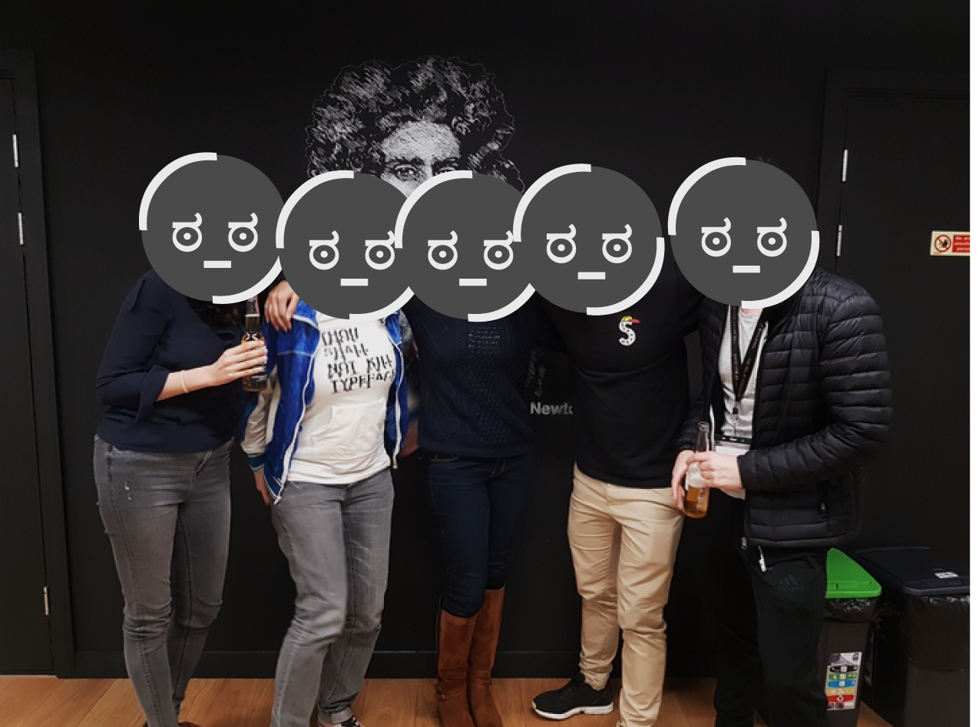
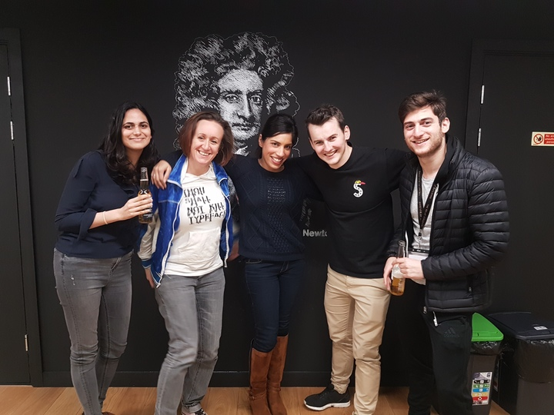
Questions..?

Slide 14
Feedback...if so...

